Slide 1


Slide 2

3
DEMAND AND SUPPLY
Notes:
Notes and teaching tips: 4, 6, 42, 49, 52, and 62.
To view a full-screen figure during a class, click the expand button.
To return to the previous slide, click the shrink button.
To advance to the next slide, click anywhere on the full screen figure.
Applying the principles of economics to interpret and understand the news is a major goal of the principles course. You can encourage your students in this activity by using the features called Economics in the News.
(1) Before each class, scan the news and select two or three headlines that are relevant to your session today. There is always something that works. Read the headline and ask for comments, interpretation, discussion. Pose questions arising from it that motivate today’s class. At the end of the class, return to the questions and answer them with the tools you’ve been explaining.
(2) Once or twice a semester, set an assignment, for credit, with the following instructions:
(a) Find a news article about an economic topic that you find interesting.
(b) Make a short bullet-list summary of the article.
(c) Write and illustrate with appropriate graphs an economic analysis of the key points in the article.
Use the Economics in the News features in your textbook as models.

Slide 3
After studying this chapter, you will be able to:
Describe a competitive market and think about a price as an opportunity cost
Explain the influences on demand
Explain the influences on supply
Explain how demand and supply determine prices and quantities bought and sold
Use the demand and supply model to make predictions about changes in prices and quantities

Slide 4
Markets and Prices
A market is any arrangement that enables buyers and sellers to get information and do business with each other.
A competitive market is a market that has many buyers and many sellers so no single buyer or seller can influence the price.
The money price of a good is the amount of money needed to buy it.
The relative price of a good—the ratio of its money price to the money price of the next best alternative good—is its opportunity cost.
Notes:
Before you jump into the demand-supply model, be sure that your students understand that a price in economics is a relative price and that a relative price is an opportunity cost. Also spend some class time ensuring that they appreciate the key lessons of Chapter 2:
a) Prosperity comes from specialization and exchange.
b) Specialization and exchange requires the social institutions of property rights and markets.
c) We must understand how markets work.
You might like to explain that the most competitive markets are explicitly organized as auctions. An interesting market to describe is that at Aalsmeer in Holland, which handles a large percentage of the world’s fresh cut flowers. Roses grown in Columbia are flown to Amsterdam, auctioned at Aalsmeer, and are in vases in New York, London, and Tokyo all in less than a day. You can find interesting videos about this market on You Tube. Here are two links:
http://www.youtube.com/watch?v=V2CK2TatM_U
http://www.youtube.com/watch?v=6MlFkEvvaJ4

Slide 5
Demand
If you demand something, then you
1. Want it,
2. Can afford it, and
3. Have made a definite plan to buy it.
Wants are the unlimited desires or wishes people have for goods and services. Demand reflects a decision about which wants to satisfy.
The quantity demanded of a good or service is the amount that consumers plan to buy during a particular time period, and at a particular price.

Slide 6
Demand
The Law of Demand
The law of demand states:
Other things remaining the same, the higher the price of a good, the smaller is the quantity demanded; and …
the lower the price of a good, the larger is the quantity demanded.
Why does a change in the price change the quantity demanded? Two reasons:
Substitution effect
Income effect
Notes:
Estimating the demand for Coke (or bottled water) in the classroom.
Of the hundreds of classroom experiments that are available today, very few are worth the time they take to conduct. The classic demand-revealing experiment is one of the most productive and worthwhile ones.
Bring to class two bottles of ice-cold, ready-to-drink Coke, bottled water, or sports drink. (If your class is very large, bring six bottles).
Tell the students that you have these drinks and ask them to indicate if they would like one. Most hands will go up and you are now ready to make two points:
1. The students have just revealed a want but not a demand.
2. You don’t have enough bottles to satisfy their wants, so you need an allocation mechanism.
Ask the students to suggest some allocation mechanisms. You might get suggestions such as: give them to the oldest, the youngest, the tallest, the shortest, the first-to-the-front-of-the-class. For each one, point out the difficulty/inefficiency/inequity.
If no one suggests selling them to the highest bidder, tell the class that you are indeed going to do just that. Tell them that this auction is real. The winner will get the drink and will pay.
Now ask for a show of hands of those who have some cash and can afford to buy a drink. Explain that these indicate an ability to buy but not a definite plan to buy.

Slide 7
Demand
Substitution Effect
When the relative price (opportunity cost) of a good or service rises, people seek substitutes for it, so the quantity demanded of the good or service decreases.
Income Effect
When the price of a good or service rises relative to income, people cannot afford all the things they previously bought, so the quantity demanded of the good or service decreases.

Slide 8
Demand
Demand Curve and Demand Schedule
The term demand refers to the entire relationship between the price of the good and quantity demanded of the good.
A demand curve shows the relationship between the quantity demanded of a good and its price when all other influences on consumers’ planned purchases remain the same.

Slide 9
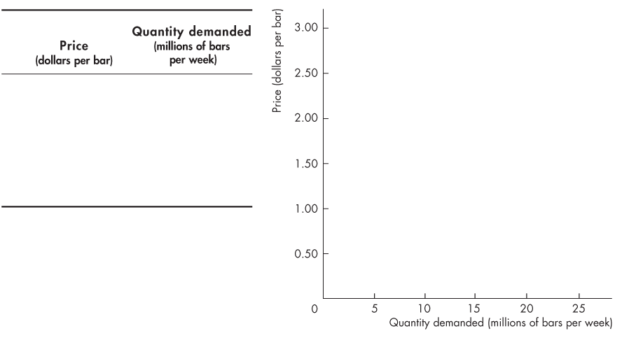
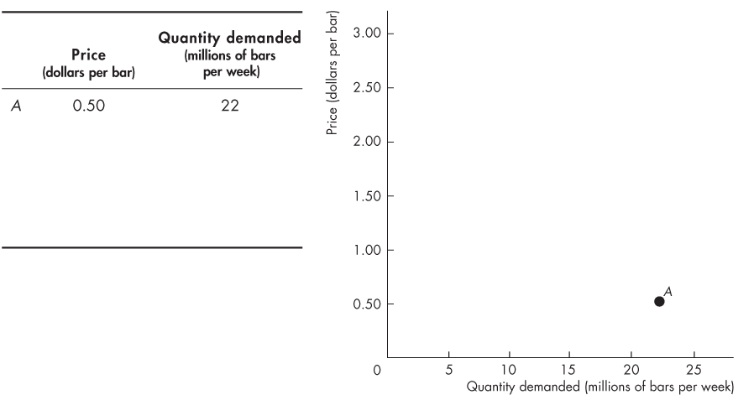
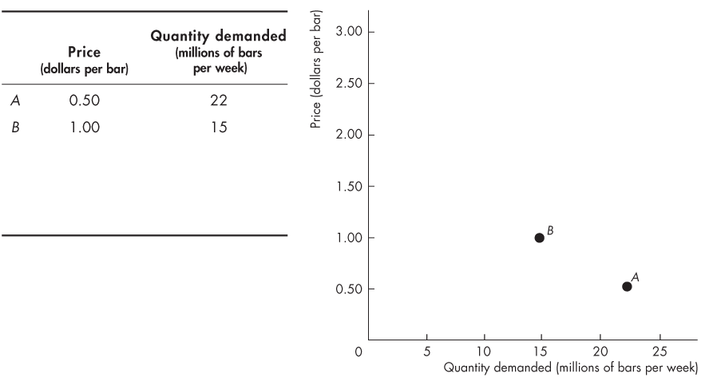
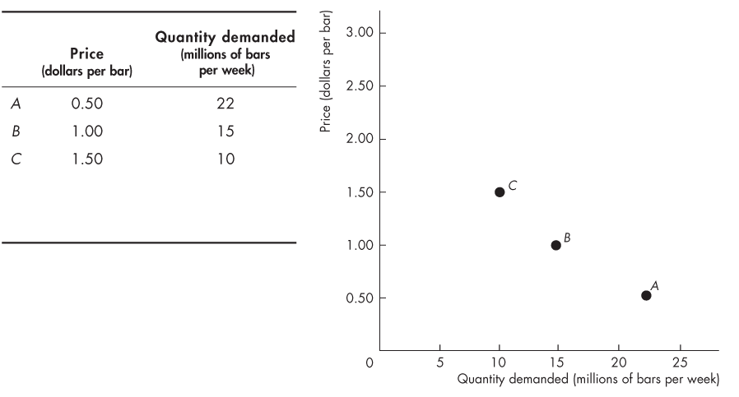
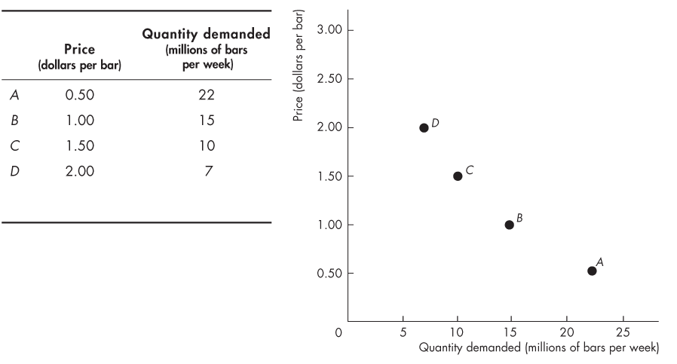
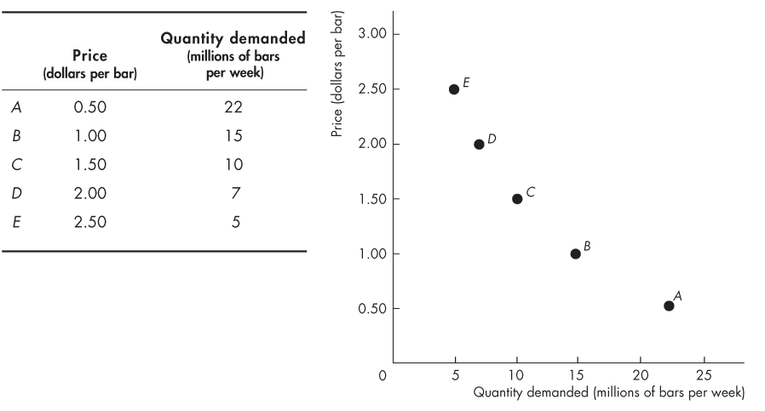
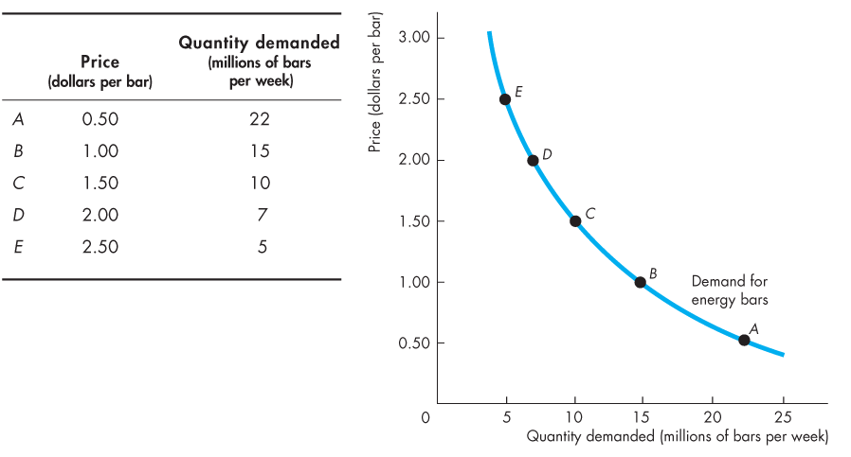

Demand
Figure 3.1 shows a demand curve for energy bars.

Slide 11
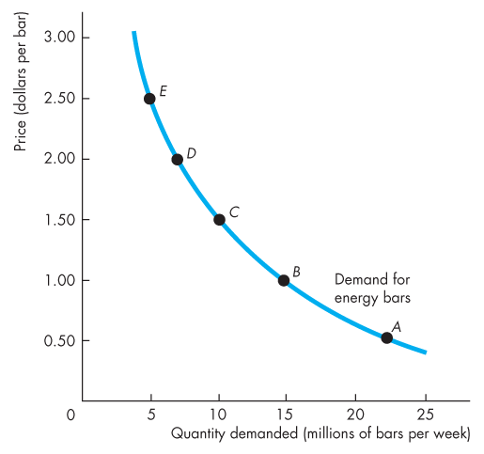
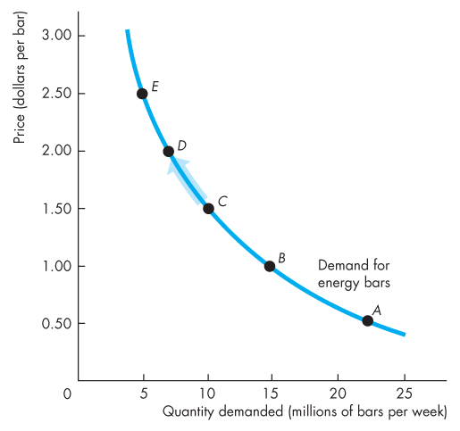
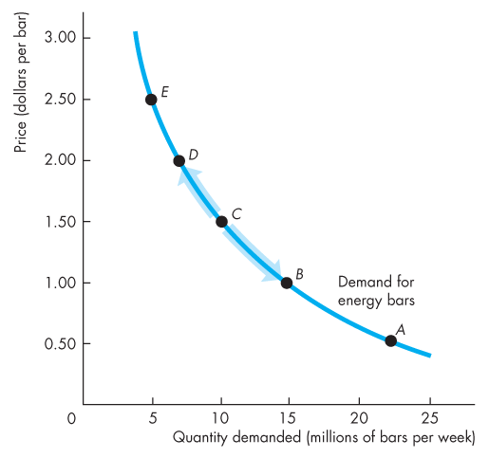
Demand
A rise in the price, other things remaining the same, brings a decrease in the quantity demanded and a movement up along the demand curve.
A fall in the price, other things remaining the same, brings an increase in the quantity demanded and a movement down along the demand curve.

Slide 12
Demand
Willingness and Ability to Pay
A demand curve is also a willingness-and-ability-to-pay curve.
The smaller the quantity available, the higher is the price that someone is willing to pay for another unit.
Willingness to pay measures marginal benefit.

Slide 13
Demand
A Change in Demand
When some influence on buying plans other than the price of the good changes, there is a change in demand for that good.
The quantity of the good that people plan to buy changes at each and every price, so there is a new demand curve.
When demand increases, the demand curve shifts rightward.
When demand decreases, the demand curve shifts leftward.

Slide 14
Demand
Six main factors that change demand are:
The prices of related goods
Expected future prices
Income
Expected future income and credit
Population
Preferences

Slide 15
Demand
Prices of Related Goods
A substitute is a good that can be used in place of another good.
A complement is a good that is used in conjunction with another good.
When the price of a substitute for an energy bar rises or when the price of a complement of an energy bar falls, the demand for energy bars increases.

Slide 16
Demand
Expected Future Prices
If the price of a good is expected to rise in the future, current demand for the good increases and the demand curve shifts rightward.
Income
When income increases, consumers buy more of most goods and the demand curve shifts rightward.
A normal good is one for which demand increases as income increases.
An inferior good is a good for which demand decreases as income increases.

Slide 17
Demand
Expected Future Income and Credit
When income is expected to increase in the future or when credit is easy to obtain, the demand might increase now.
Population
The larger the population, the greater is the demand for all goods.
Preferences
People with the same income have different demands if they have different preferences.

Slide 18
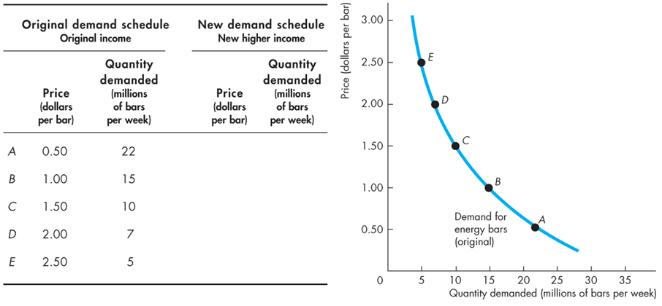
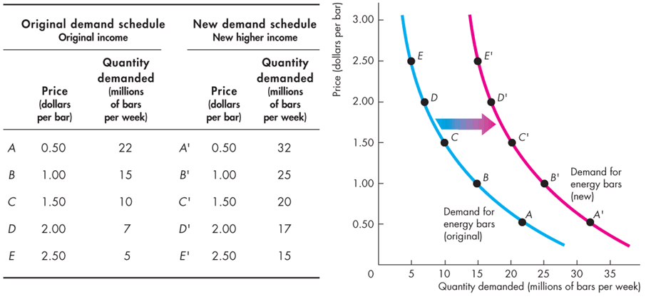
Demand
Figure 3.2 shows an increase in demand.
An increase in income increases the demand for energy bars and shifts the demand curve rightward.

Slide 20
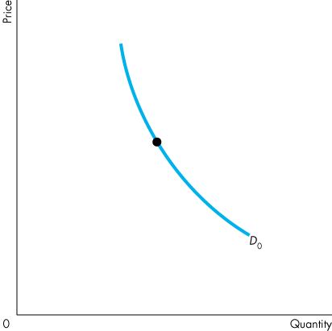
Demand
A Change in the Quantity Demanded Versus a Change in Demand
Figure 3.3 illustrates the distinction between a change in demand and a change in the quantity demanded.

Slide 21
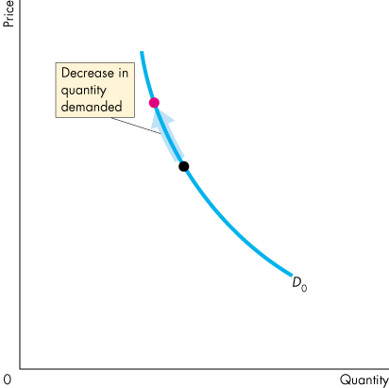
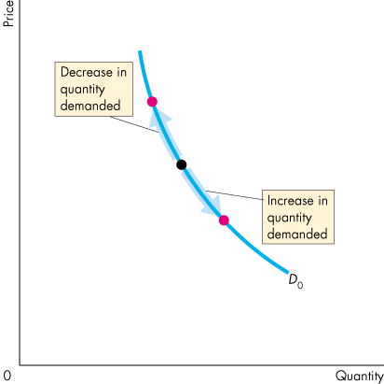
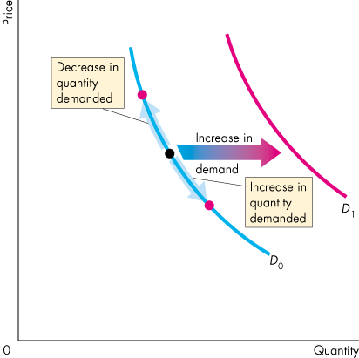
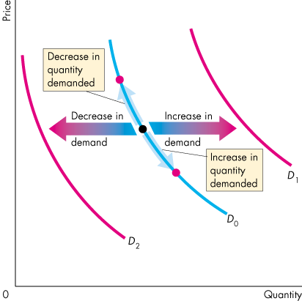

Slide 22
Demand
Movement Along the Demand Curve
When the price of the good changes and other things remain the same, the quantity demanded changes and there is a movement along the demand curve.

Slide 23
Demand
A Shift of the Demand Curve
If the price remains the same but one of the other influences on buyers’ plans changes, demand changes and the demand curve shifts.

Slide 24
Supply
If a firm supplies a good or service, then the firm
1. Has the resources and the technology to produce it,
2. Can profit from producing it, and
3. Has made a definite plan to produce and sell it.
Resources and technology determine what it is possible to produce. Supply reflects a decision about which technologically feasible items to produce.
The quantity supplied of a good or service is the amount that producers plan to sell during a given time period at a particular price.

Slide 25
Supply
The Law of Supply
The law of supply states:
Other things remaining the same, the higher the price of a good, the greater is the quantity supplied; and
the lower the price of a good, the smaller is the quantity supplied.
The law of supply results from the general tendency for the marginal cost of producing a good or service to increase as the quantity produced increases (Chapter 2, page 35).
Producers are willing to supply a good only if they can at least cover their marginal cost of production.

Slide 26
Supply
Supply Curve and Supply Schedule
The term supply refers to the entire relationship between the quantity supplied and the price of a good.
The supply curve shows the relationship between the quantity supplied of a good and its price when all other influences on producers’ planned sales remain the same.

Slide 27
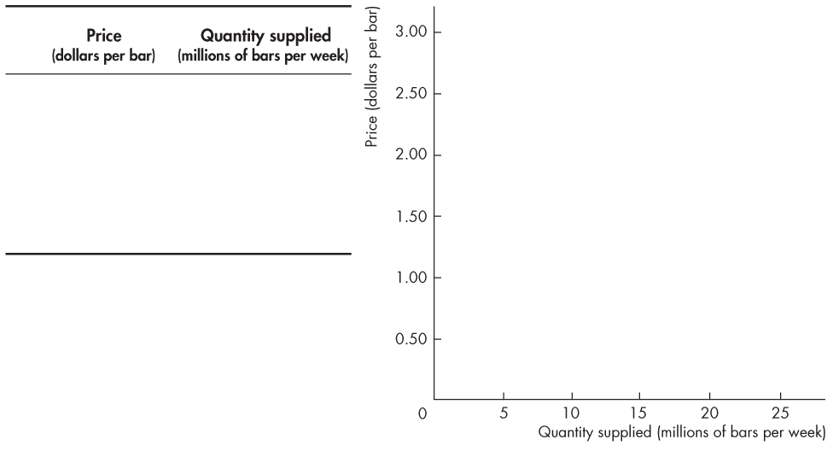
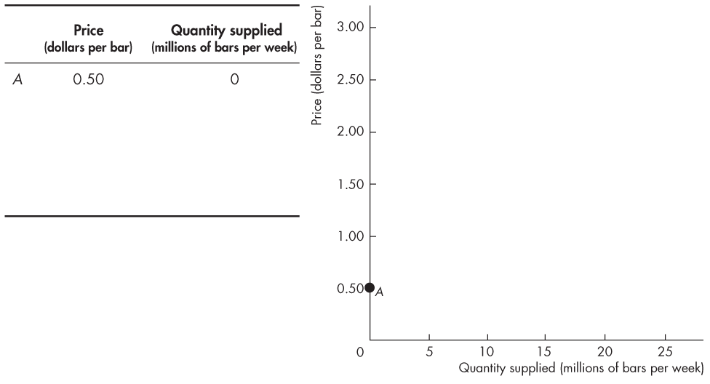
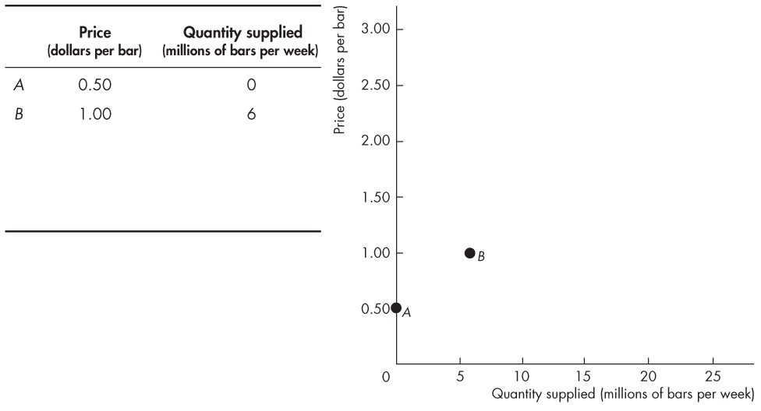
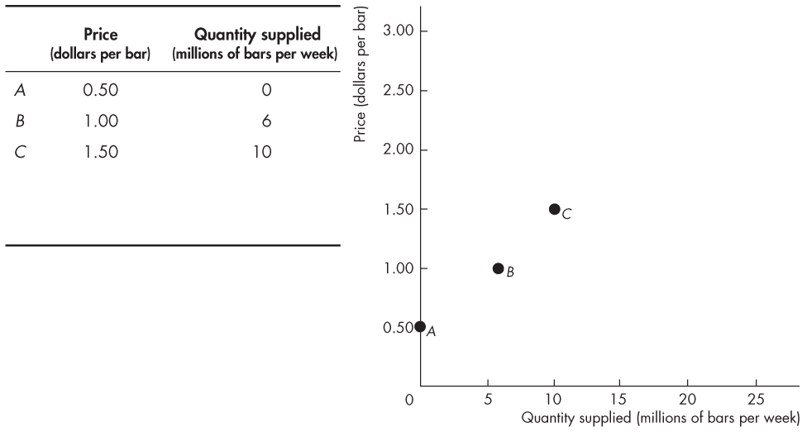
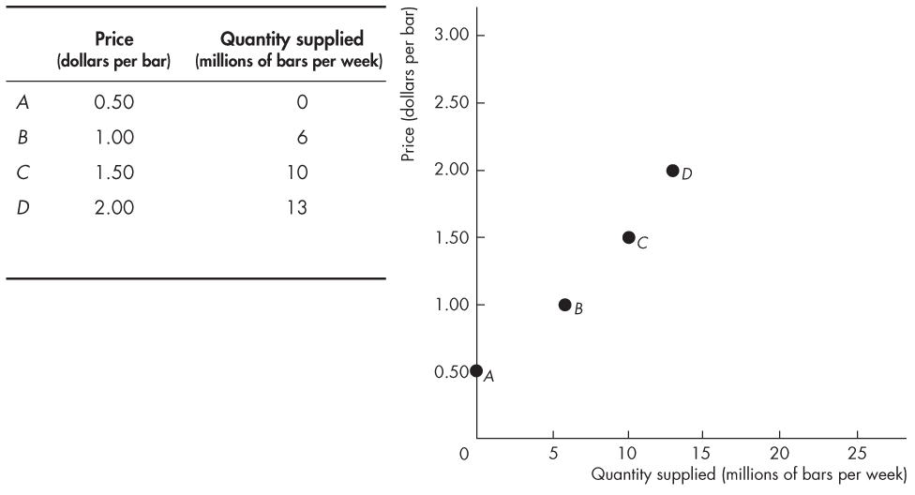
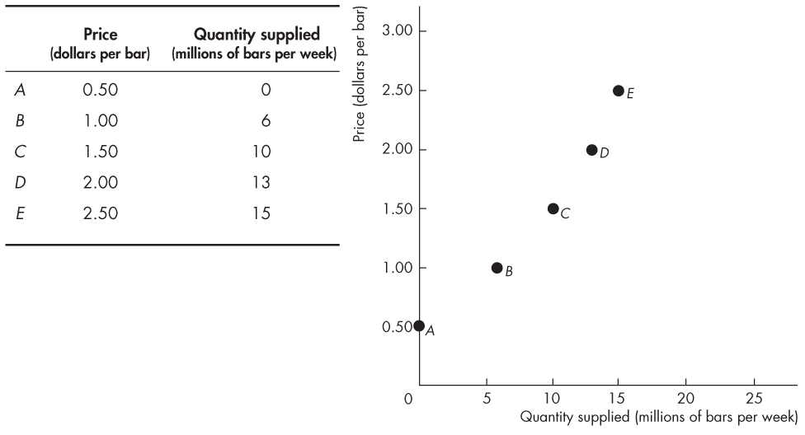
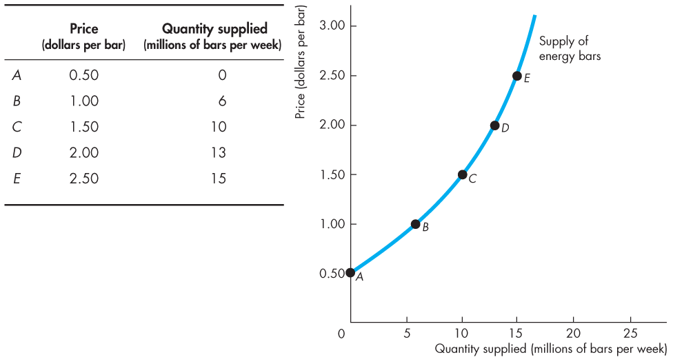
Supply
Figure 3.4 shows a supply curve of energy bars.
A rise in the price, other things remaining the same, brings an increase in the quantity supplied.

Slide 29
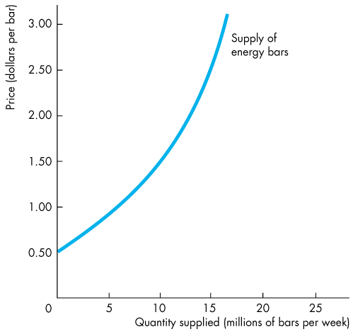

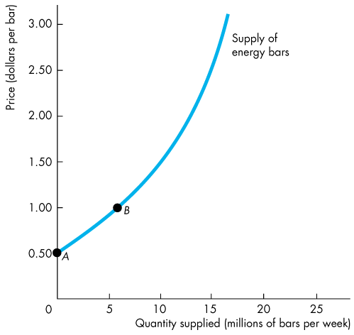
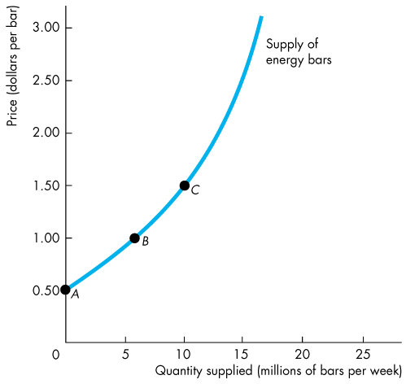
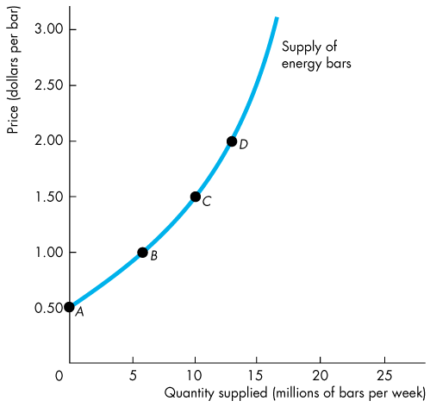
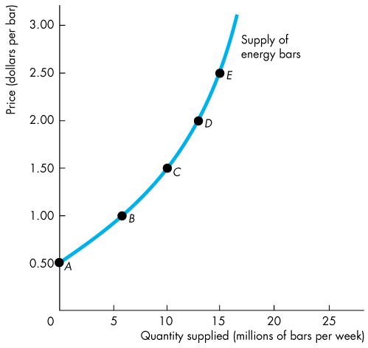
Supply
Minimum Supply Price
A supply curve is also a minimum-supply-price curve.
As the quantity produced increases, marginal cost increases.
The lowest price at which someone is willing to sell an additional unit rises.
This lowest price is marginal cost.

Slide 30
Supply
A Change in Supply
When some influence on selling plans other than the price of the good changes, there is a change in supply of that good.
The quantity of the good that producers plan to sell changes at each and every price, so there is a new supply curve.
When supply increases, the supply curve shifts rightward.
When supply decreases, the supply curve shifts leftward.

Slide 31
Supply
The six main factors that change supply of a good are
The prices of factors of production
The prices of related goods produced
Expected future prices
The number of suppliers
Technology
State of nature

Slide 32
Supply
Prices of Factors of Production
If the price of a factor of production used to produce a good rises, the minimum price that a supplier is willing to accept for producing each quantity of that good rises.
So a rise in the price of a factor of production decreases supply and shifts the supply curve leftward.

Slide 33
Supply
Prices of Related Goods Produced
A substitute in production for a good is another good that can be produced using the same resources.
The supply of a good increases if the price of a substitute in production falls.
Goods are complements in production if they must be produced together.
The supply of a good increases if the price of a complement in production rises.

Slide 34
Supply
Expected Future Prices
If the price of a good is expected to rise in the future, supply of the good today decreases and the supply curve shifts leftward.
The Number of Suppliers
The larger the number of suppliers of a good, the greater is the supply of the good. An increase in the number of suppliers shifts the supply curve rightward.

Slide 35
Supply
Technology
Advances in technology create new products and lower the cost of producing existing products.
So advances in technology increase supply and shift the supply curve rightward.
The State of Nature
The state of nature includes all the natural forces that influence production—for example, the weather.
A natural disaster decreases supply and shifts the supply curve leftward.

Slide 36
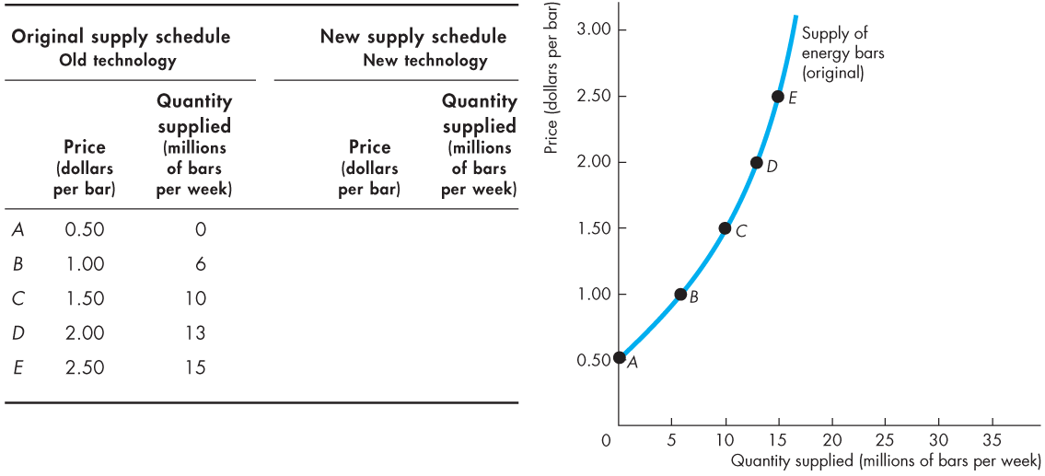
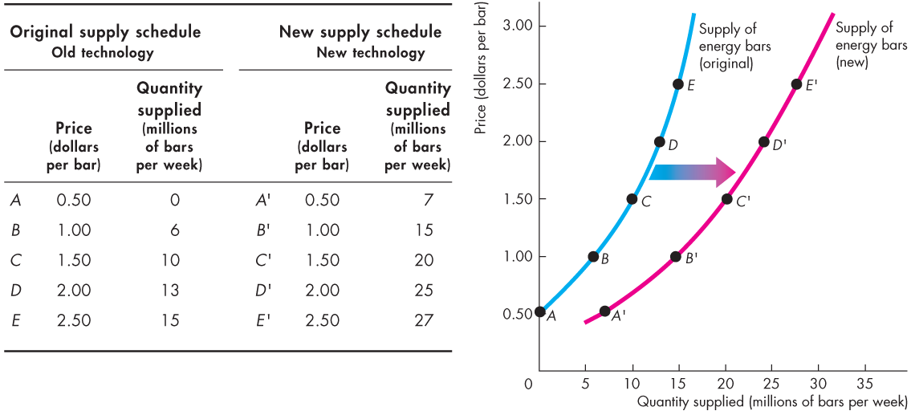
Supply
Figure 3.5 shows an increase in supply.
An advance in the technology increases the supply of energy bars and shifts the supply curve rightward.

Slide 38
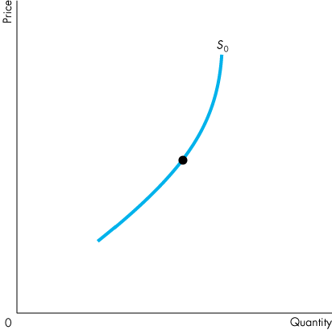
Supply
A Change in the Quantity Supplied Versus a Change in Supply
Figure 3.6 illustrates the distinction between a change in supply and a change in the quantity supplied.

Slide 39
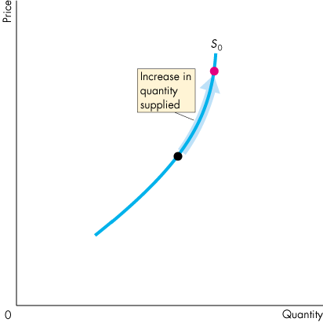
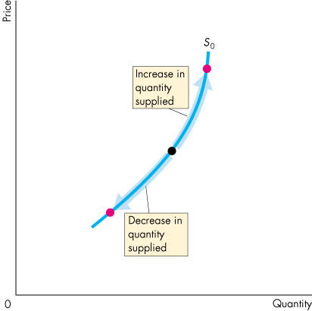
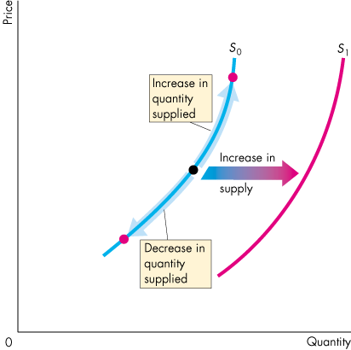
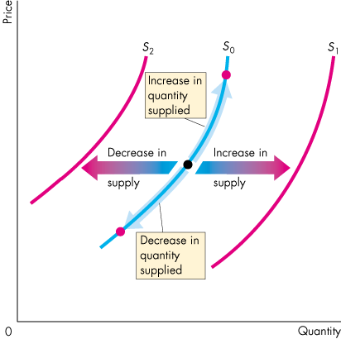

Slide 40
Supply
Movement Along the Supply Curve
When the price of the good changes and other influences on sellers’ plans remain the same, the quantity supplied changes and there is a movement along the supply curve.

Slide 41
Supply
A Shift of the Supply Curve
If the price remains the same but some other influence on sellers’ plans changes, supply changes and the supply curve shifts.

Slide 42
Market Equilibrium
Equilibrium is a situation in which opposing forces balance each other. Equilibrium in a market occurs when the price balances the plans of buyers and sellers.
The equilibrium price is the price at which the quantity demanded equals the quantity supplied.
The equilibrium quantity is the quantity bought and sold at the equilibrium price.
Price regulates buying and selling plans.
Price adjusts when plans don’t match.
Notes:
The magic of market equilibrium and the forces that bring it about and keep the market there need to be demonstrated with the basic diagram, with intuition, and, if you’ve got the time, with hard evidence in the form of further class activity.
You might want to begin with the demand curve experiment and explain that in that market, the supply was fixed (vertical supply curve) at the quantity of bottles that you brought to class. The equilibrium occurred where the market demand curve (demand by the students) intersected your supply curve.
Then you might use the supply curve experiment and explain that in that market, demand was fixed (vertical demand curve) at the quantity that you had decided to buy. The equilibrium occurred where the market supply curve (supply by the students) intersected your demand curve.
Point out that the trades you made in your little economy made buyers and sellers better off.
If you want to devote a class to equilibrium and the gains from trade in a market, you might want to assign the My Lab Economics market experiment that you can find in the Interactive Activities Chapter IA.

Slide 43
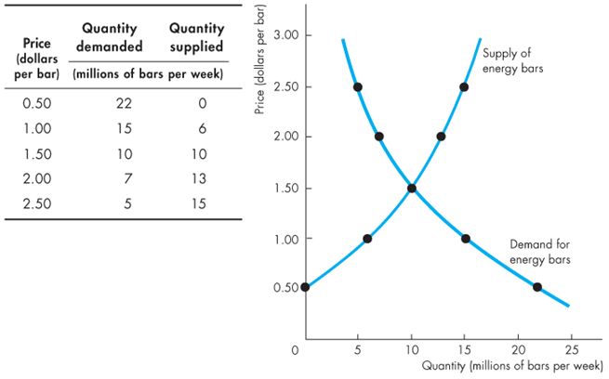
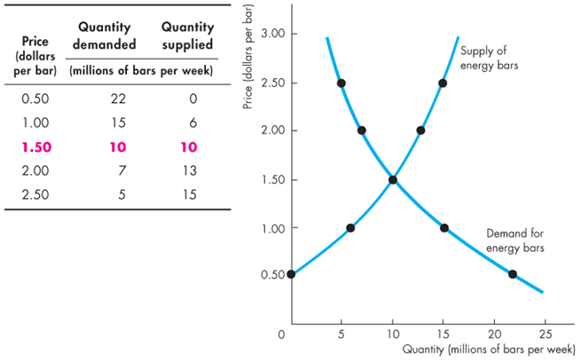
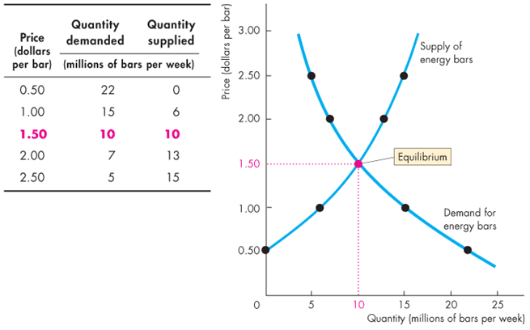
Market Equilibrium
Figure 3.7 illustrates the market equilibrium—the price at which quantity demanded equals quantity supplied.

Slide 44
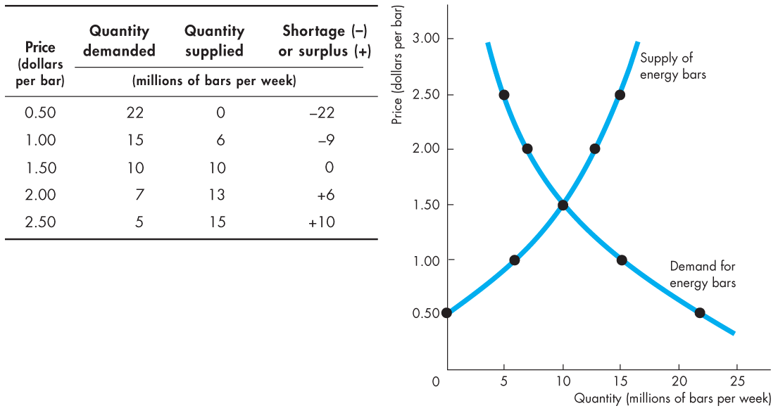

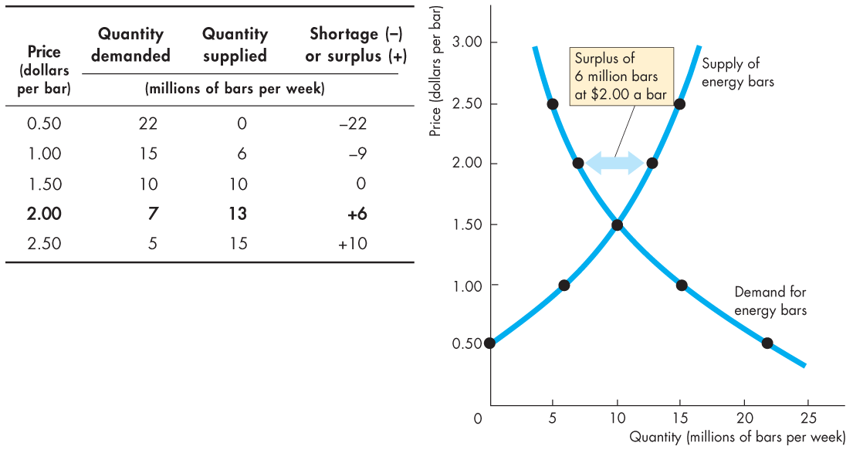
Market Equilibrium
Price as a Regulator
If the price is $2.00 a bar, the quantity supplied exceeds the quantity demanded.
There is a surplus of 6 million energy bars.

Slide 45

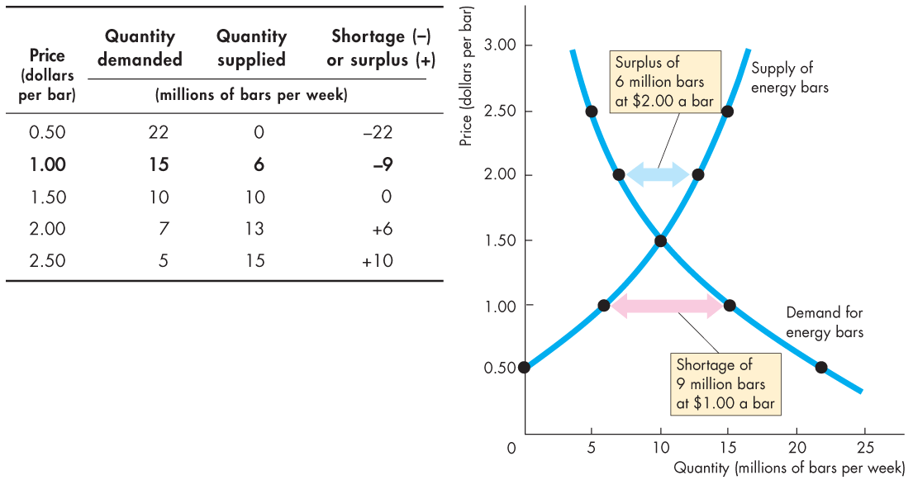

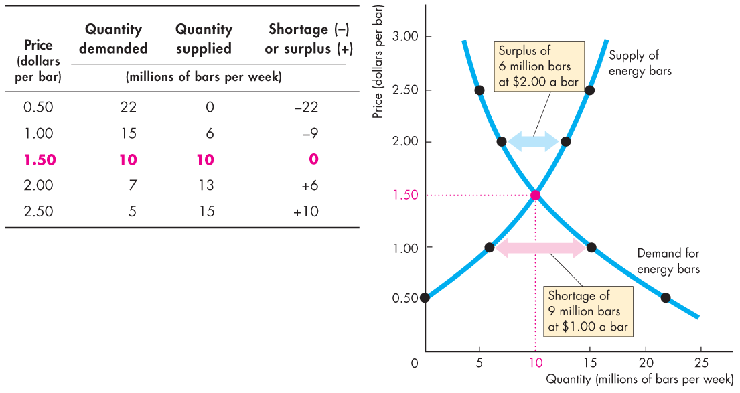
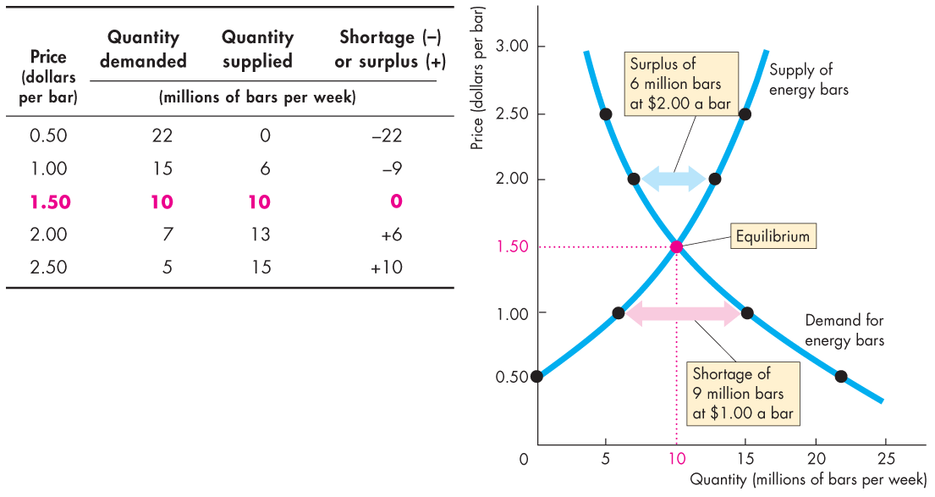

Slide 46
Market Equilibrium
Price as a Regulator
If the price is $1.00 a bar, the quantity demanded exceeds the quantity supplied.
A shortage of 9 million bars.

Slide 47
Market Equilibrium
Price as a Regulator
If the price is $1.50 a bar, the quantity supplied equals the quantity demanded.
No shortage or surplus of bars.

Slide 48
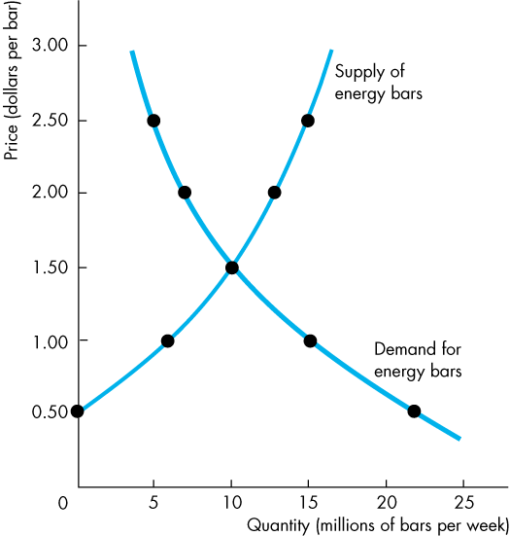
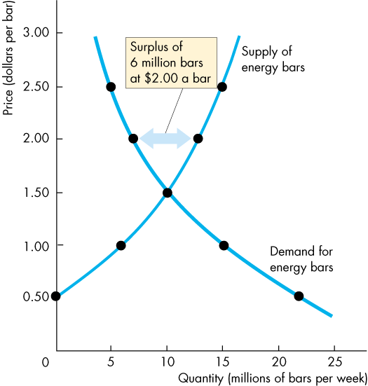
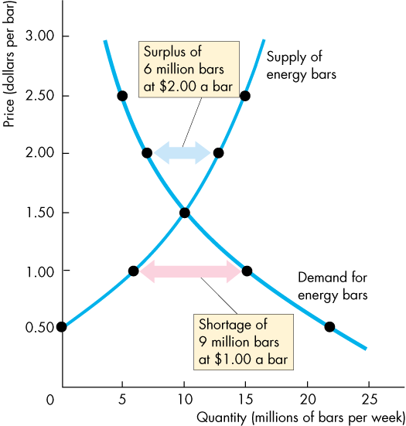
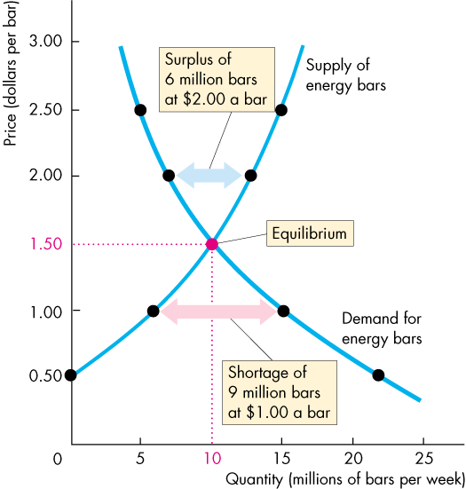
Market Equilibrium
Price Adjustments
At prices above the equilibrium price, a surplus forces the price down.
At prices below the equilibrium price, a shortage forces the price up.
At the equilibrium price, buyers’ plans and sellers’ plans agree and the price doesn’t change until an event changes demand or supply.

Slide 49
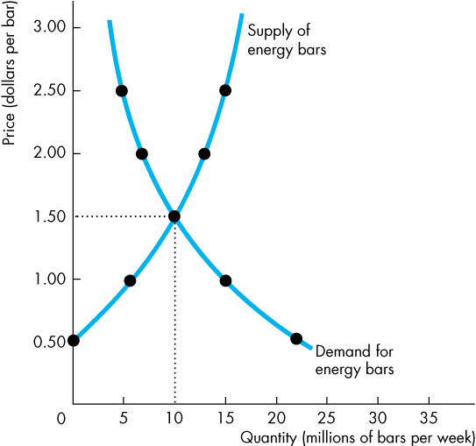
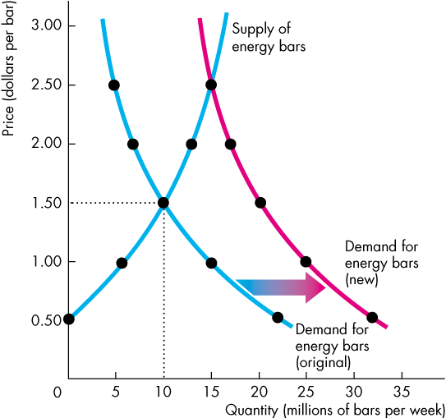

Predicting Changes in Price and Quantity
An Increase in Demand
Figure 3.8 shows that when demand increases the demand curve shifts rightward.
At the original price, there is now a shortage.
The price rises, and the quantity supplied increases along the supply curve.
Notes:
The whole chapter builds up to this section, which now brings all the elements of demand, supply, and equilibrium together to make predictions.
Students are remarkably ready to guess the consequences of some event that changes either demand or supply or both. They must be encouraged to work out the answer and draw the diagram.
Explain that the way to answer any question that seeks a prediction about the effects of some events on a market has five steps. Walk them through the steps and have one or two students work some examples in front of the class. The five steps are:
1.Draw a demand-supply diagram and label the axes with the price and quantity of the good or service in question.
2. Think about the events that you are told occur and decide whether they change demand, supply, both demand and supply, or neither demand nor supply.
3. Do the events that change demand or supply bring an increase or a decrease?
4. Draw the new demand curve and supply curve on the diagram. Be sure to shift the curves in the correct direction—leftward for decrease and rightward for increase. (Lots of students want to move the curves upward for increase and downward for decrease—works ok for demand but exactly wrong for supply. Emphasize the left-right shift.)
5. Find the new equilibrium and compare it with the original one.
Walk them through the steps and have one or two students work some examples in front of the class.
It is critical at this stage to return to the distinction between a change in demand (supply) and a change in the quantity demanded (supplied). You can now use these distinctions to describe the effects of events that change market outcomes.
At this point, the students know enough for it to be worthwhile emphasizing the magic of the market’s ability to coordinate plans and reallocate resources.
Classroom activity
Check out Economics in the News: The Market for College Education

Slide 50






Slide 51



Predicting Changes in Price and Quantity
A Decrease in Demand
The figure shows that when demand decreases the demand curve shifts leftward.
At the original price, there is now a surplus.
The price falls, and the quantity supplied decreases along the supply curve.

Slide 52



Predicting Changes in Price and Quantity
An Increase in Supply
Figure 3.9 shows that when supply increases the supply curve shifts rightward.
At the original price, there is now a surplus.
The price falls, and the quantity demanded increases along the demand curve.
Notes:
Classroom activity
Check out Economics in the News: The Market for Coffee

Slide 53






Slide 54



Predicting Changes in Price and Quantity
A Decrease in Supply
The figure shows that when supply decreases the supply curve shifts leftward.
At the original price, there is now a shortage.
The price rises, and the quantity demanded decreases along the demand curve.
Notes:
Classroom activity
Check out Economics in the News: The Market for Orange Juice

Slide 55
Predicting Changes in Price and Quantity
Changes in Both Demand and Supply
A change in both demand and supply changes the equilibrium price and the equilibrium quantity.
Figure 3.10 illustrates changes in the same direction.
Figure 3.11 illustrates changes in opposite directions.

Slide 56





Predicting Changes in Price and Quantity
Both Demand and Supply Change in the Same Direction
An increase in demand and an increase in supply increase the equilibrium quantity.
The change in equilibrium price is uncertain because the increase in demand raises the price and the increase in supply lowers it.

Slide 58





Predicting Changes in Price and Quantity
A decrease in both demand and supply decreases the equilibrium quantity.
The change in equilibrium price is uncertain because the decrease in demand lowers the price and the decrease in supply raises the price.

Slide 60





Predicting Changes in Price and Quantity
Both Demand and Supply Change in Opposite Directions
A decrease in demand and an increase in supply lowers the equilibrium price.
The change in equilibrium quantity is uncertain because the decrease in demand decreases the quantity and the increase in supply increases it.

Slide 62





Predicting Changes in Price and Quantity
An increase in demand and a decrease in supply raises the equilibrium price.
The change in equilibrium quantity is uncertain because the increase in demand increases the quantity and the decrease in supply decreases it.
Notes:
Applying the principles of economics to interpret and understand the news is a major goal of the principles course. You can encourage your students in this activity by using the feature: Economics in the News.
(1) Before each class, scan the news and select two or three headlines that are relevant to your session today. There is always something that works. Read the headline and ask for comments, interpretation, discussion. Pose questions arising from it that motivate today’s class. At the end of the class, return to the questions and answer them with the tools you’ve been explaining.
(2) Once or twice a semester, set an assignment, for credit, with the following instructions:
(a) Find a news article about an economic topic that you find interesting.
(b) Make a short bullet-list summary of the article.
(c) Write and illustrate with appropriate graphs an economic analysis of the key points in the article.
Use the Economics in the News feature in your textbook as models.

